Slide 1
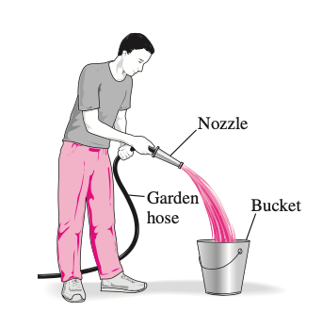
Chemical Engineering Thermodynamics Lecture 5 Flow Process Xiaofei Xu

Slide 2
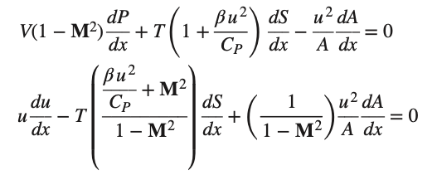
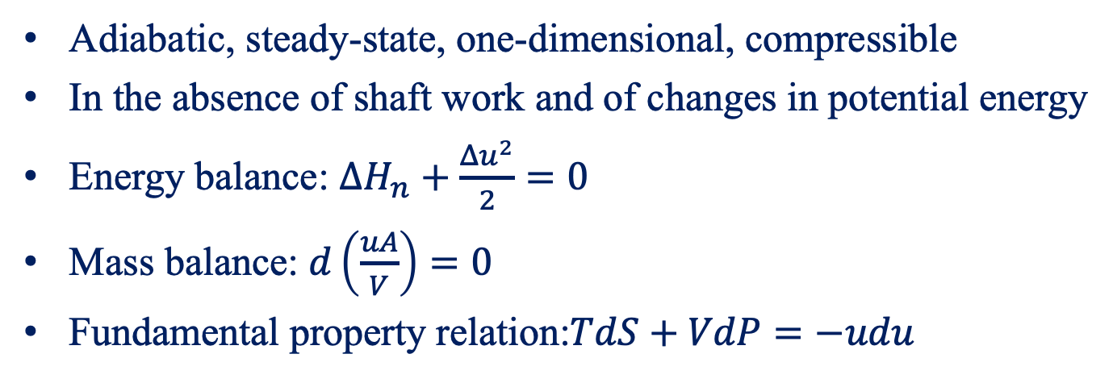

Duct Flow of Compressible Fluids
Adiabatic, steady-state, one-dimensional, compressible
In the absence of shaft work and of changes in potential energy
Energy balance: $ΔH_{n}+\frac{Δu^{2}}{2}=0$
Mass balance: $d\left(\frac{uA}{V}\right)=0$
Fundamental property relation:$TdS+VdP=−udu$
$$M=u/c$$

Slide 3
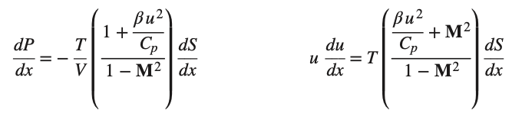
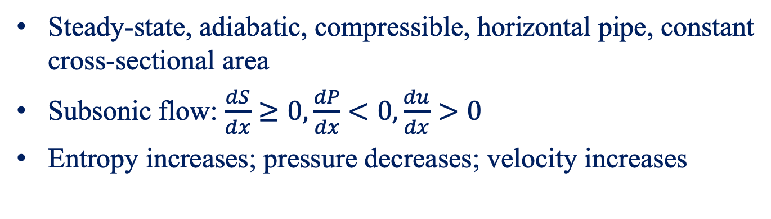
Pipe Flow
Steady-state, adiabatic, compressible, horizontal pipe, constant cross-sectional area
Subsonic flow: $\frac{dS}{dx}≥0,\frac{dP}{dx}<0,\frac{du}{dx}>0$
Entropy increases; pressure decreases; velocity increases

Slide 4
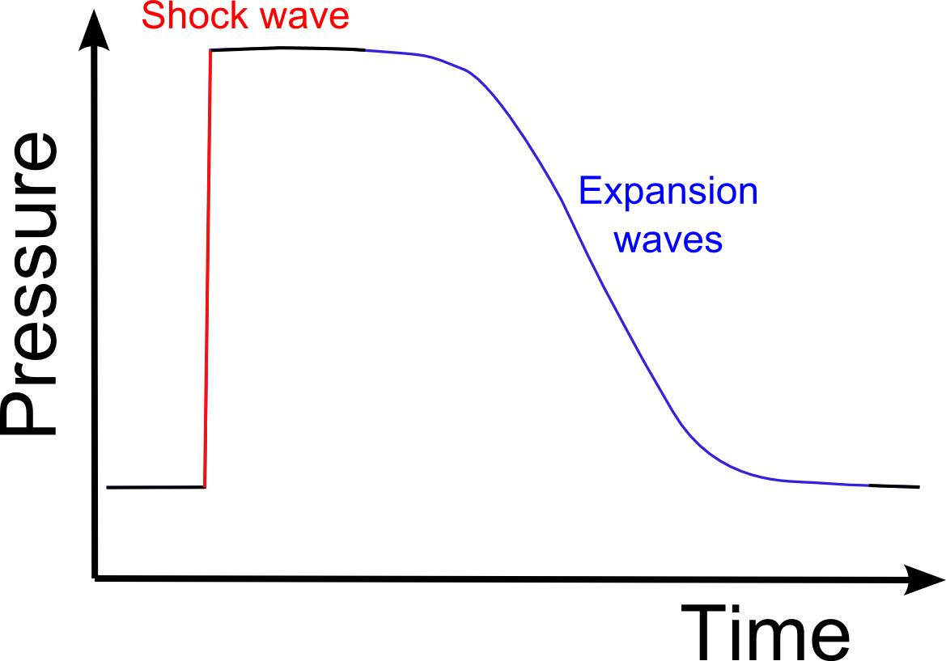

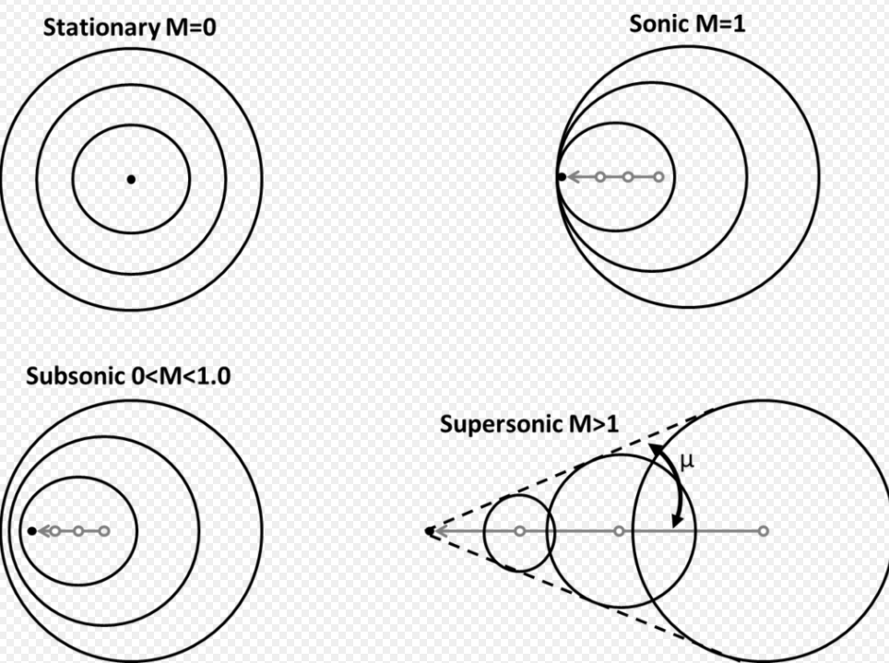
Shock Wave
NASA, 2019

Slide 5
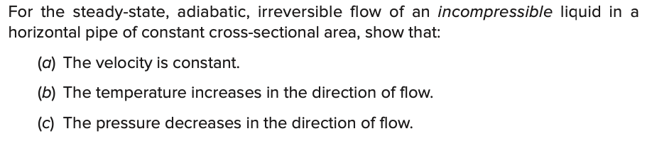
Example

Slide 6
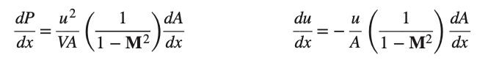
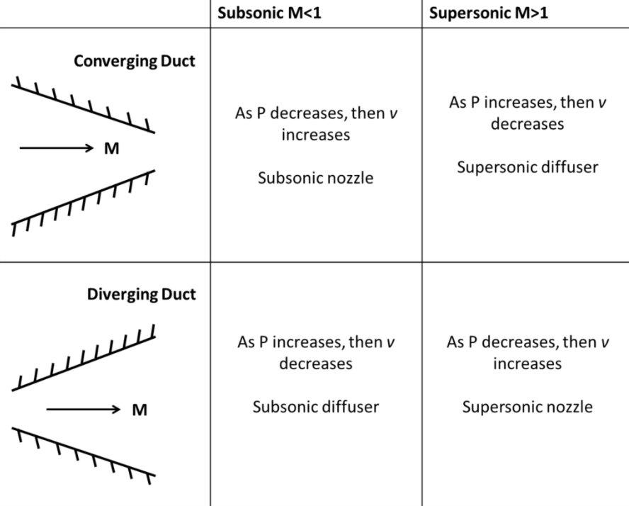
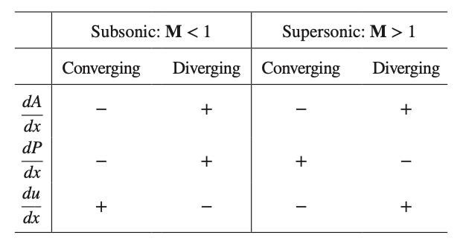
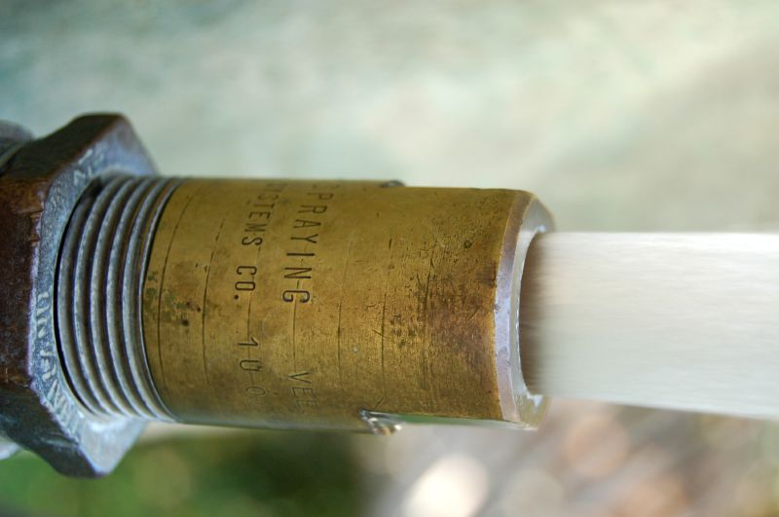
Nozzles

Slide 7
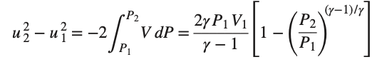
Isentropic flow of ideal-gas

Slide 8
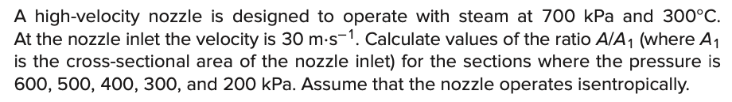
Example

Slide 9
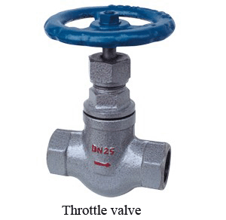
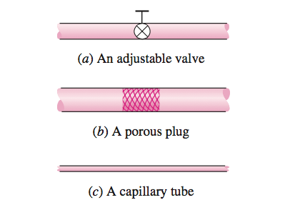
Throttling Valves

Slide 10
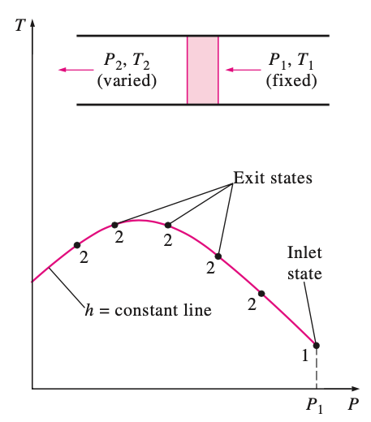
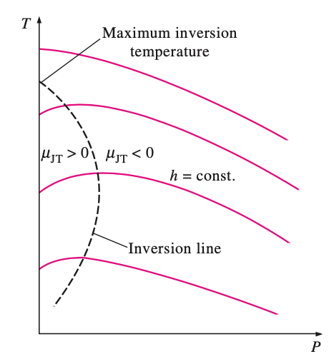
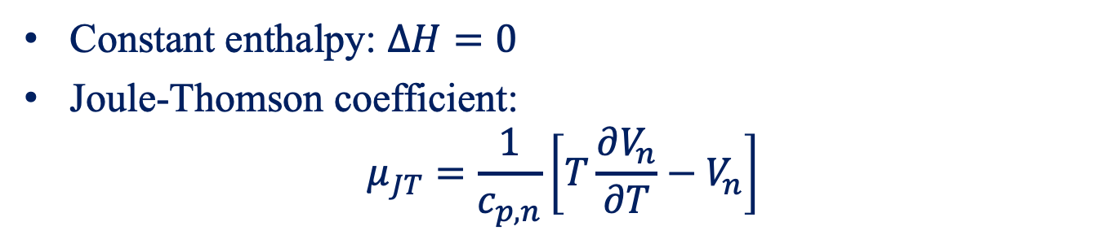
Throttling Process
Constant enthalpy: $ΔH=0$
Joule-Thomson coefficient:
$$μ_{JT}=\frac{1}{c_{p,n}}\left[T\frac{∂V_{n}}{∂T}−V_{n}\right]$$

Slide 11
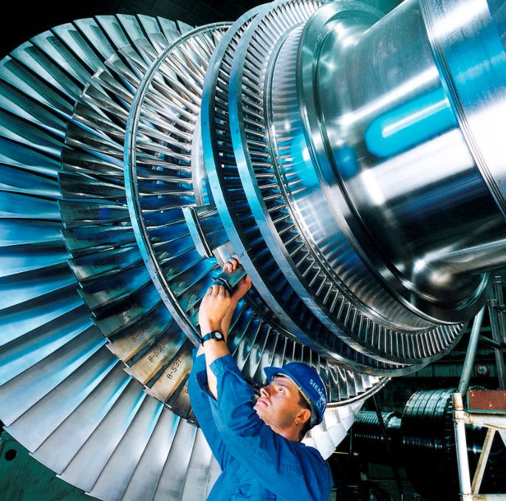
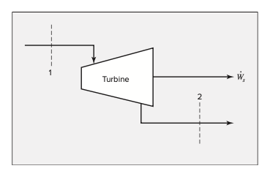
Turbine (Expander)
The expansion of a gas in a nozzle to produce a high-velocity stream in a process that coverts internal energy into kinetic energy.
stream turbine

Slide 12
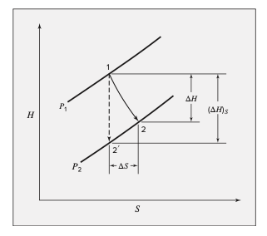
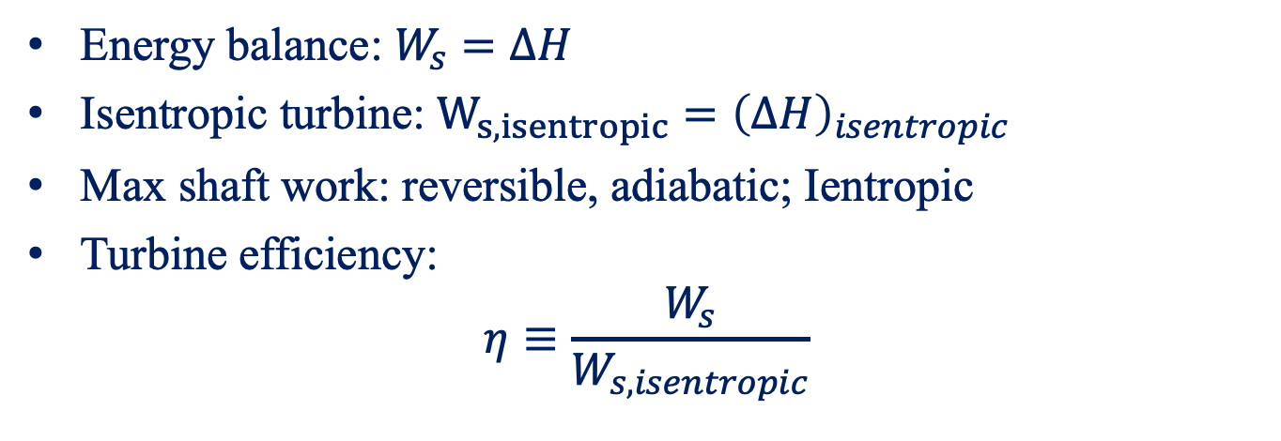
Turbine (Expander)
Energy balance: $W_{s}=ΔH$
Isentropic turbine: $W_{s,isentropic}={\left(ΔH\right)}_{isentropic}$
Max shaft work: reversible, adiabatic; Ientropic
Turbine efficiency:
$$η≡\frac{W_{s}}{W_{s,isentropic}}$$

Slide 13
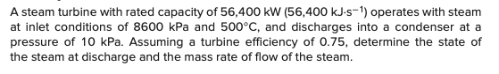
Example

Slide 14
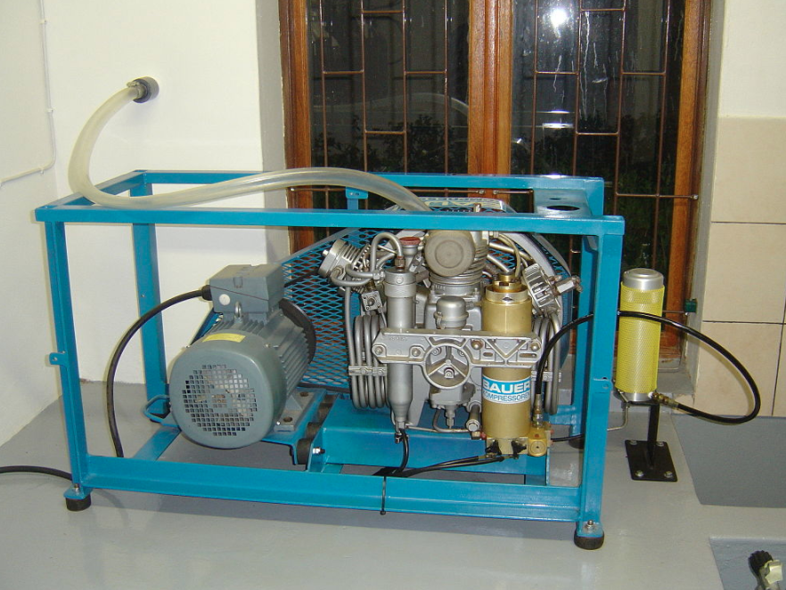
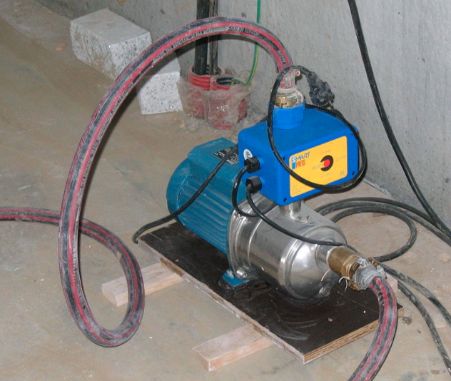
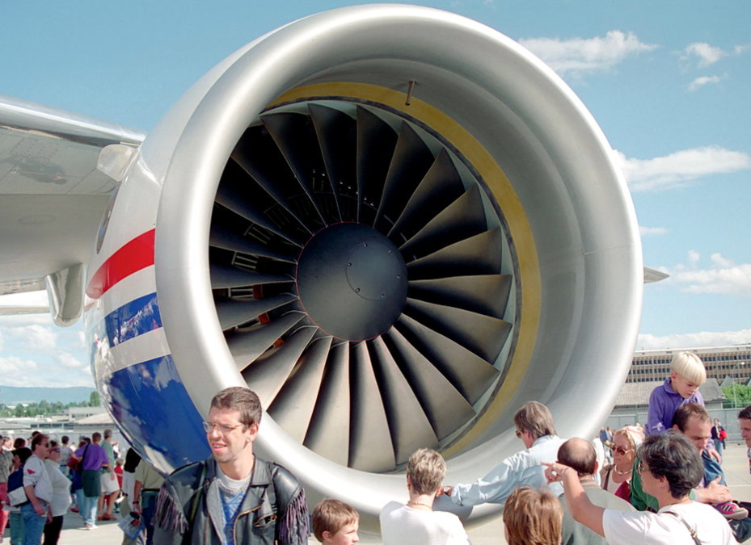
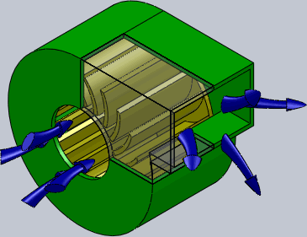
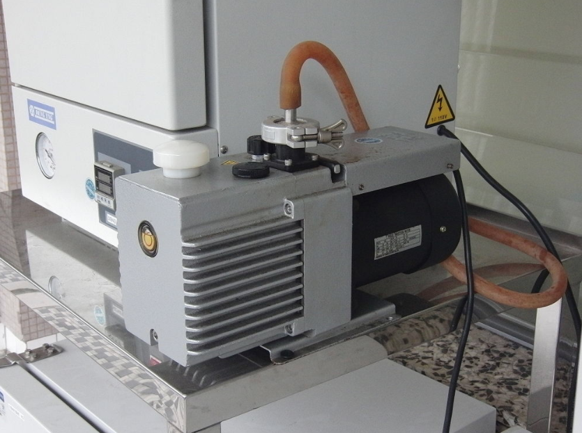
Compression Processes
Expansion: pressure reductions
Compression: pressure increases
compressor
pump
fan
blower
vacuum pumps
Transport fluid
Fluidization solid
Reduce pressure
….

Slide 15
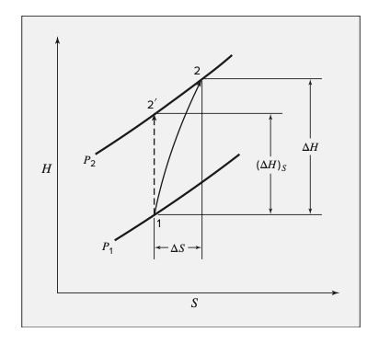
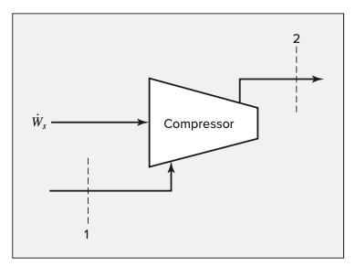
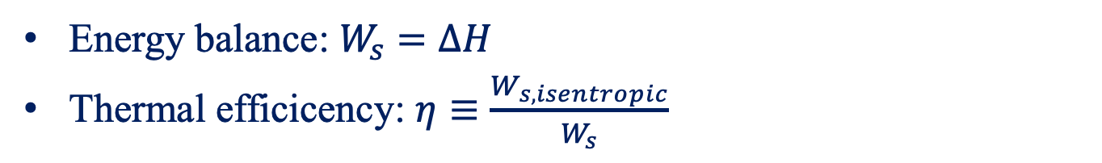
Compressor
Energy balance: $W_{s}=ΔH$
Thermal efficicency: $η≡\frac{W_{s,isentropic}}{W_{s}}$

Slide 16
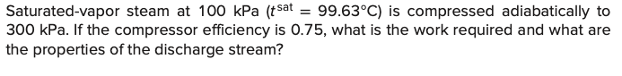
Example

Slide 17
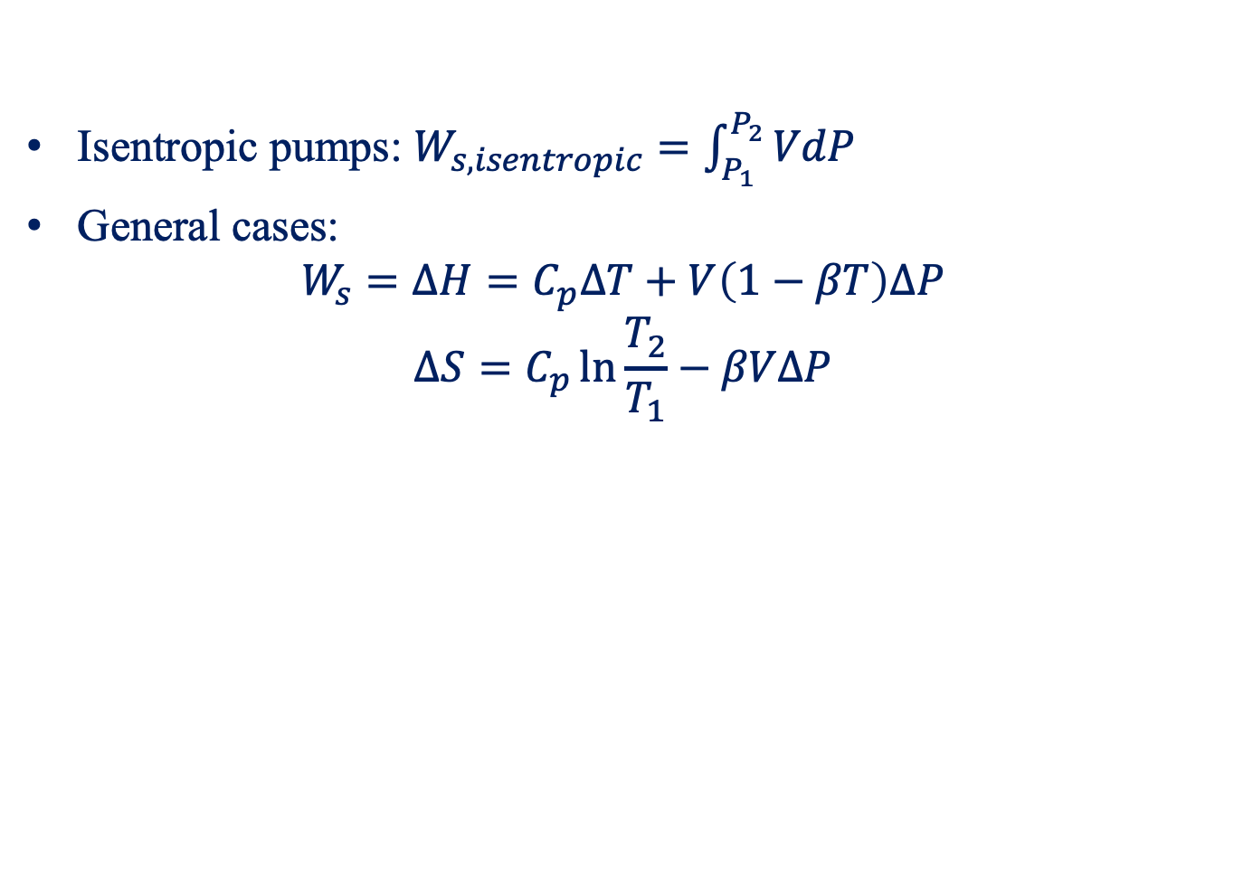
Pumps
Isentropic pumps: $W_{s,isentropic}=\int_{P_{1}}^{P_{2}}{VdP}$
General cases:
$$W_{s}=ΔH=C_{p}ΔT+V\left(1−βT\right)ΔP$$
$$ΔS=C_{p}\ln{\frac{T_{2}}{T_{1}}}−βVΔP$$

Slide 18
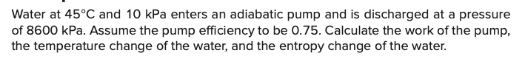
Example

